Slide 1
Analysing Railway Infrastructure utilisation
A Geospatial Approach
Stuart Gordon
Supervisors: Dr Craig Robson, Professor Roberto Palacin
Oliver Bratton (Network Rail)

Slide 2
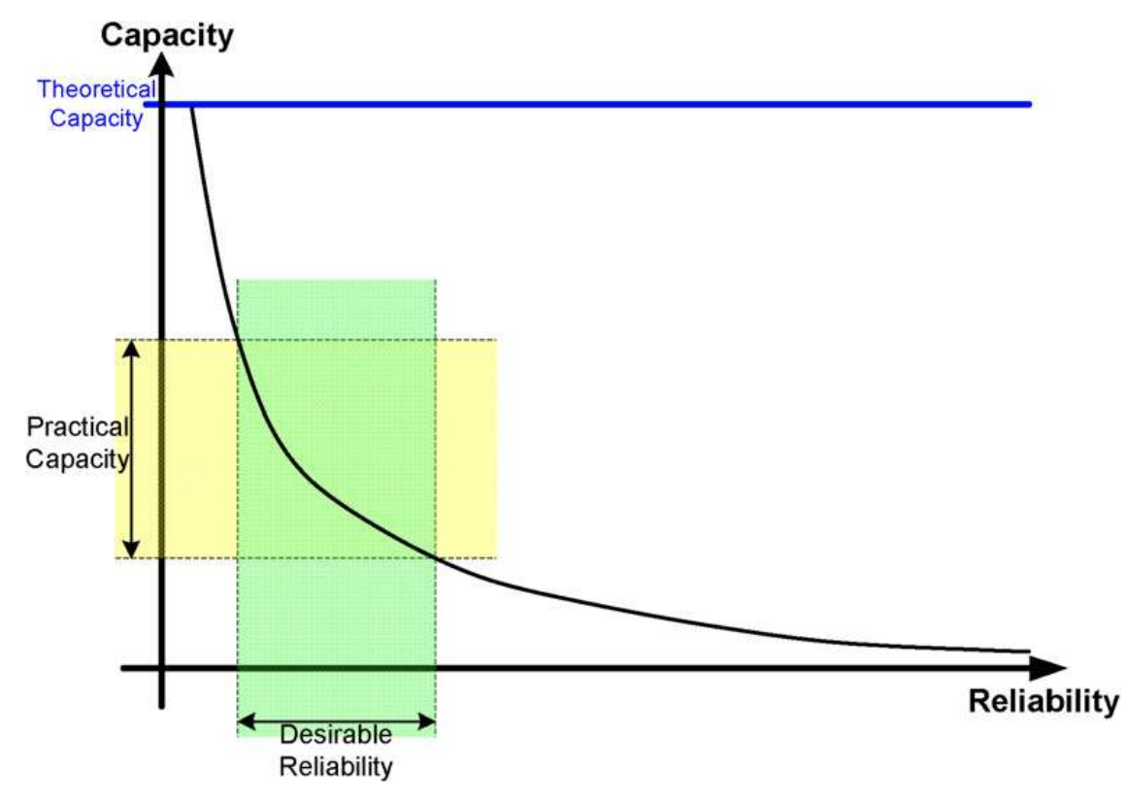
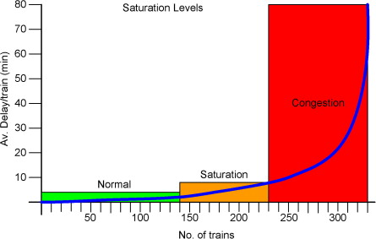
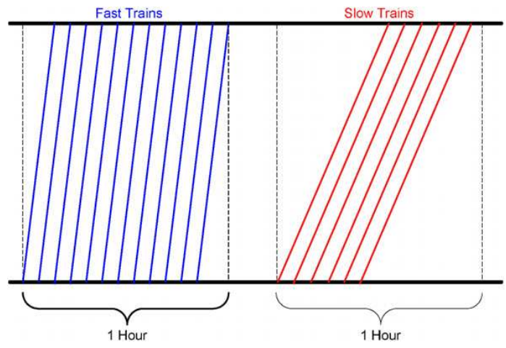
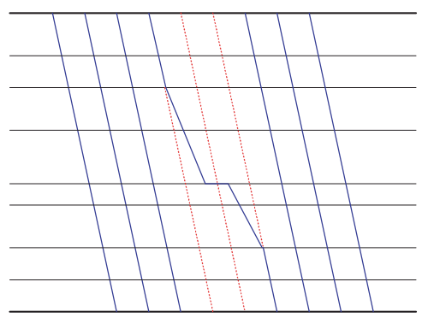
Railway Capacity & Utilisation
Capacity
Infrastructure
Systems
Train Service
Utilisation
Efficiency
Performance vs Capacity
Uses
Investment
Planning
Performance Monitoring
Abril et al, 2008. An assessment of railway capacity. Transportation Research Part E: Logistics and Transportation Review, 44(5), pp.774-806.
Notes:
Railway Capacity
Definition: Maximum number of trains that can safely run on a railway line in a given period.
Factors Determining Capacity:
Track infrastructure (single/double/multiple tracks).
Signaling systems.
Frequency of train services.
Track maintenance schedules.
Capacity Enhancement:
Track upgrades (adding additional tracks).
Improved signaling technology.
Reduction of bottlenecks (e.g., junctions).
Station improvements (e.g., platform extensions).
Railway Utilisation
Definition: Actual number of trains running on a railway line compared to its capacity.
Significance:
Reflects efficiency of the railway system.
Indicator of congestion and potential delays.
Optimal Utilisation: Ensures a balance between high service levels and the ability to accommodate unexpected disruptions.
Over-Utilisation Risks:
Increased delays.
Reduced safety margins.
Faster wear and tear of infrastructure.
Why & How It's Used
Planning & Investment:
Timetable Creation:
Pricing Decisions:
Performance Metrics:
Safety:
Customer Satisfaction:

Slide 3
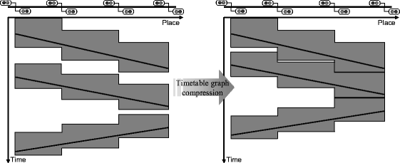
Railway Capacity & Utilisation
Capacity
Infrastructure
Systems
Train Service
Utilisation
Efficiency
Performance vs Capacity
Uses
Investment
Planning
Performance Monitoring
Landex, A. Evaluation of Railway Networks with Single Track Operation Using the UIC 406 Capacity Method. Netw Spat Econ 9, 7–23 (2009). https://doi.org/10.1007/s11067-008-9090-7
Notes:
Railway Capacity
Definition: Maximum number of trains that can safely run on a railway line in a given period.
Factors Determining Capacity:
Track infrastructure (single/double/multiple tracks).
Signaling systems.
Frequency of train services.
Track maintenance schedules.
Capacity Enhancement:
Track upgrades (adding additional tracks).
Improved signaling technology.
Reduction of bottlenecks (e.g., junctions).
Station improvements (e.g., platform extensions).
Railway Utilisation
Definition: Actual number of trains running on a railway line compared to its capacity.
Significance:
Reflects efficiency of the railway system.
Indicator of congestion and potential delays.
Optimal Utilisation: Ensures a balance between high service levels and the ability to accommodate unexpected disruptions.
Over-Utilisation Risks:
Increased delays.
Reduced safety margins.
Faster wear and tear of infrastructure.
Why & How It's Used
Planning & Investment:
Timetable Creation:
Pricing Decisions:
Performance Metrics:
Safety:
Customer Satisfaction:
Literature
Logical Infrastructure linked to Timetable
Standard Approach UIC406
Simulation over topological models
Rare use of empirical data
No validation of real world predictions
Many variations of methods and ways to optimize

Slide 4





Existing Methods
Timetable Compression
Analytical Methods
Optimization
Modeling & Simulation based
Topological Network Models
Landex, A. Evaluation of Railway Networks with Single Track Operation Using the UIC 406 Capacity Method. Netw Spat Econ 9, 7–23 (2009). https://doi.org/10.1007/s11067-008-9090-7
Notes:
Landex, A. Evaluation of Railway Networks with Single Track Operation Using the UIC 406 Capacity Method. Netw Spat Econ 9, 7–23 (2009). https://doi.org/10.1007/s11067-008-9090-7

Slide 5
Investigate Utilisation
Compare Planned against Actual Utilisation
Identify Events or Incidents
Aims

Slide 6
Geospatial Infrastructure
Spatial Temporal Graphs
Identify Differences in Utilisation
Realtime Processing
Objectives

Slide 7
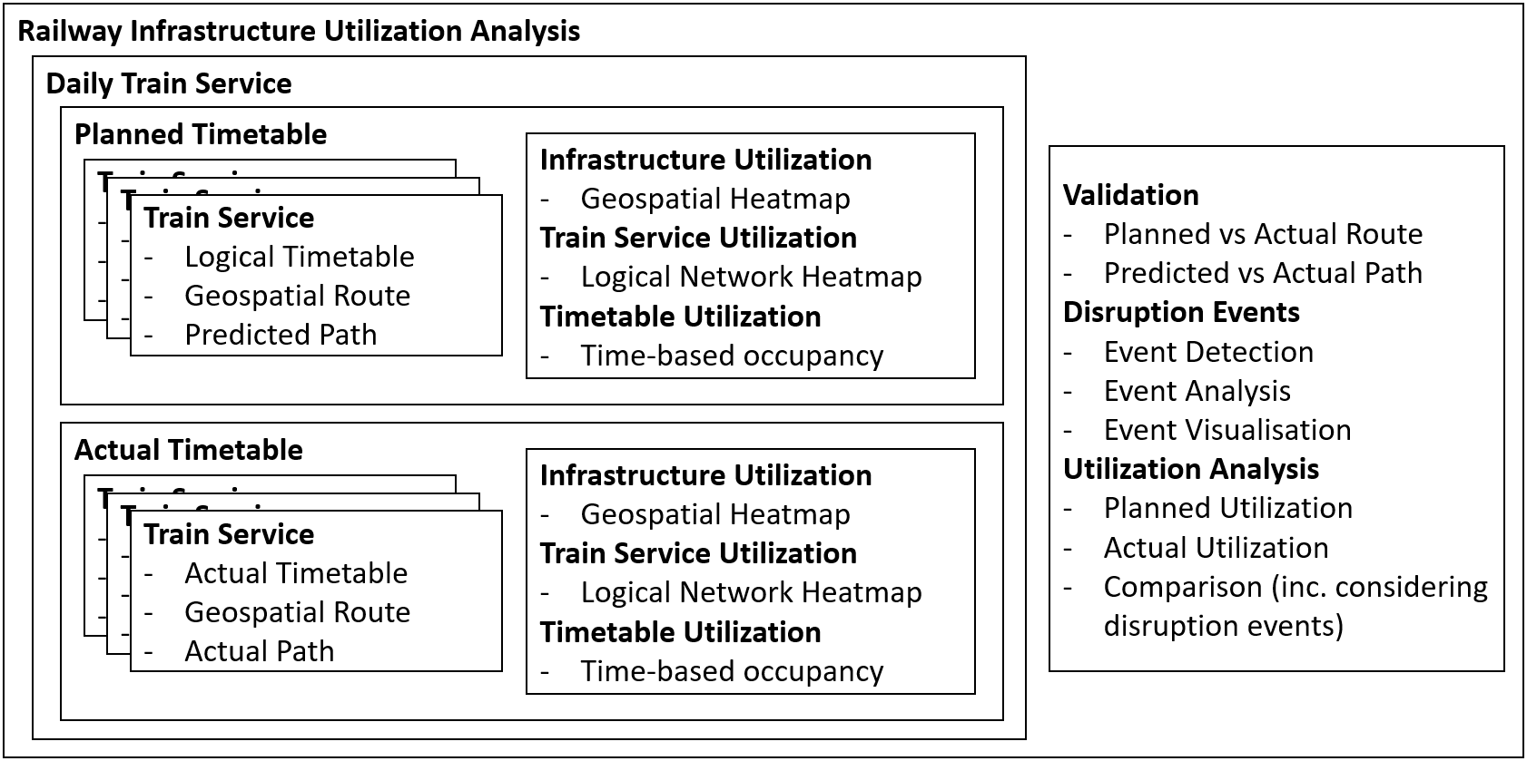
Methodology
Data Preparation
Data Processing
Calculation

Slide 8
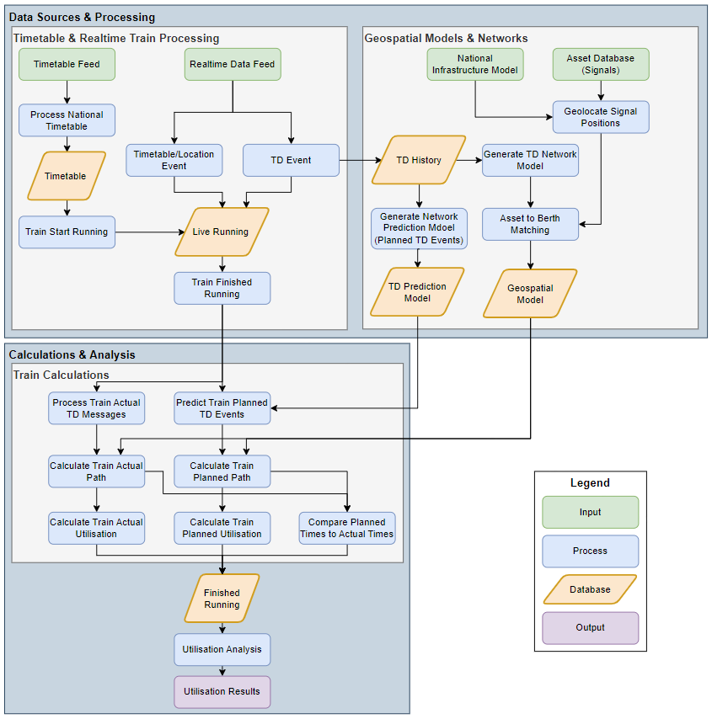
Process
Data Preparation
Data Processing
Calculation

Slide 9
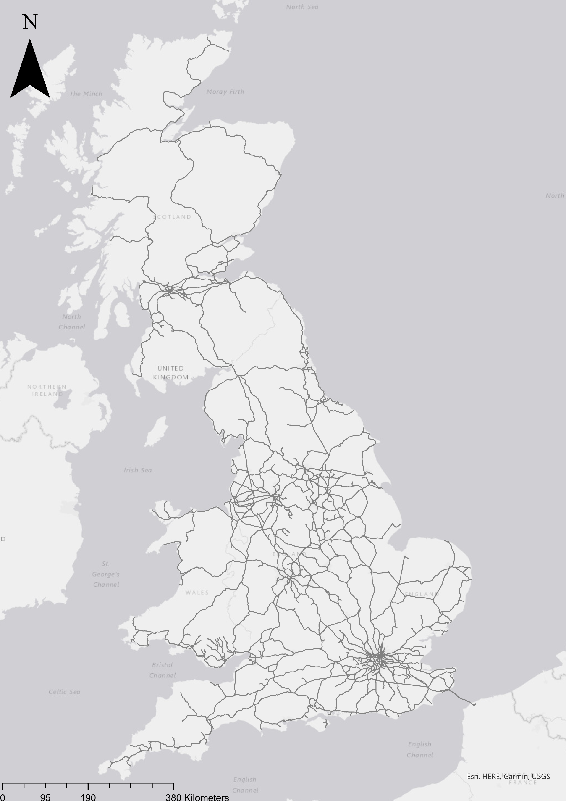
Scope
Over 20,000 Miles
15,416 edges

Slide 10
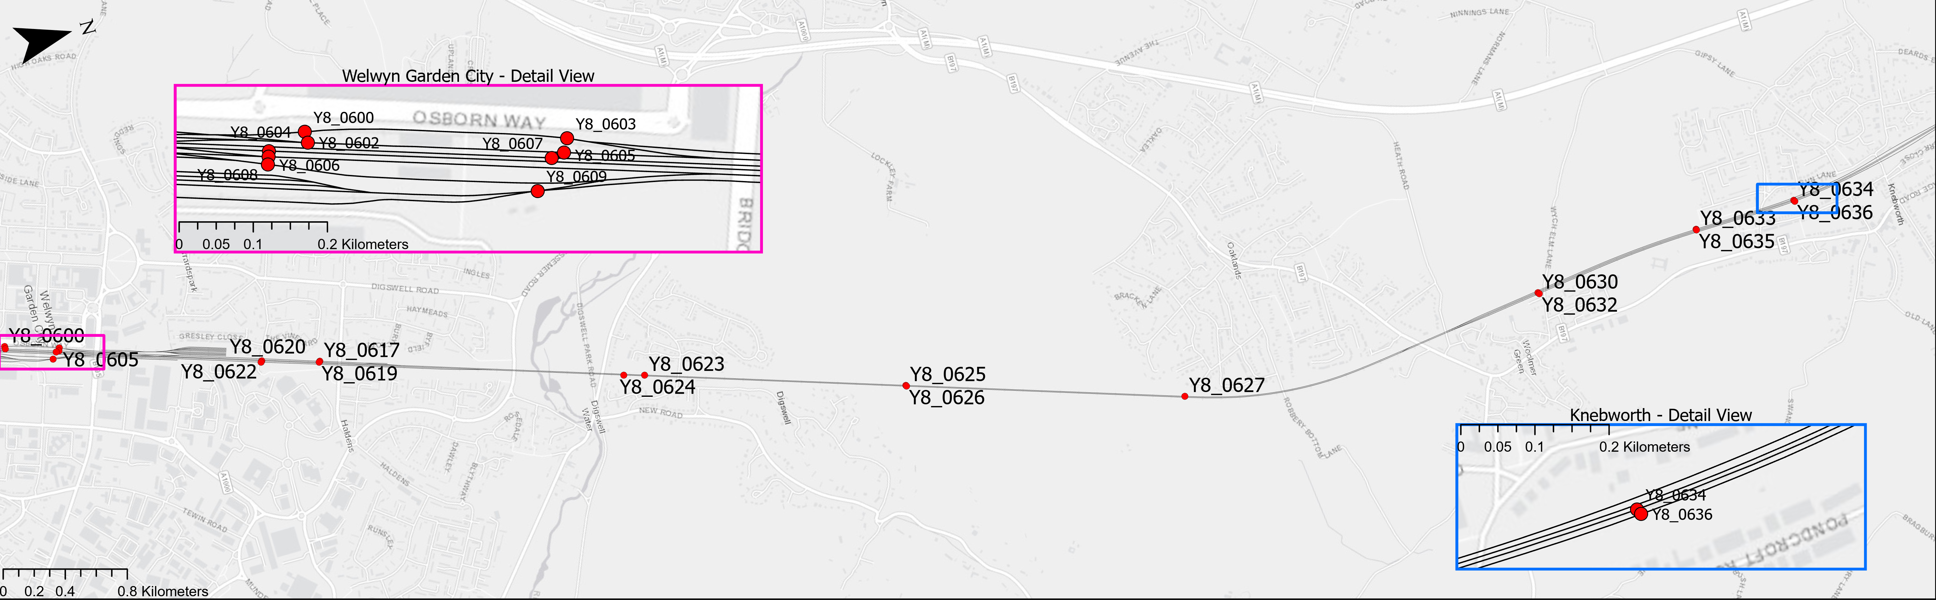
Data Preparation
Geospatial Model
Physical Assets

Slide 11
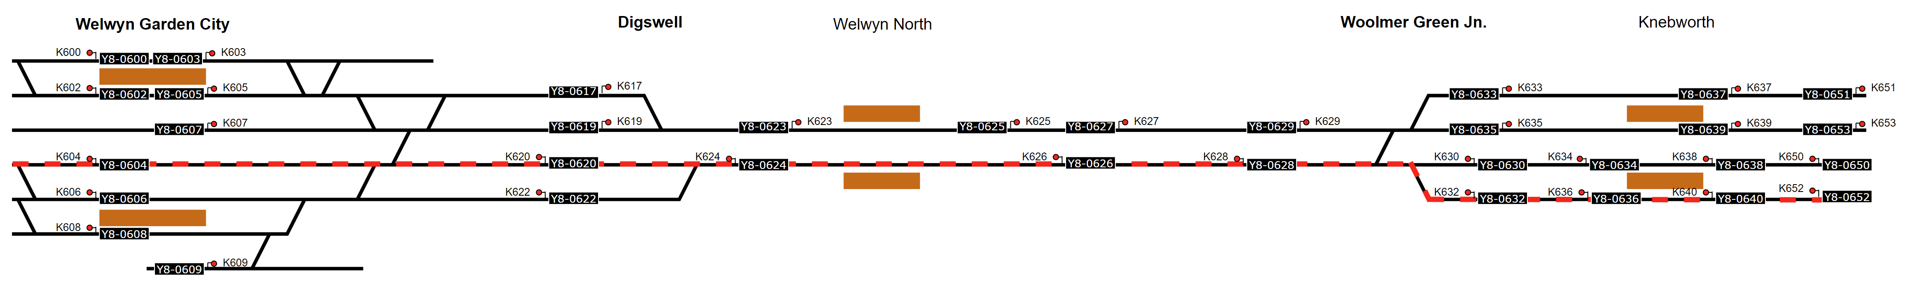
Data Processing
Logical Diagram
Logical Path

Slide 12
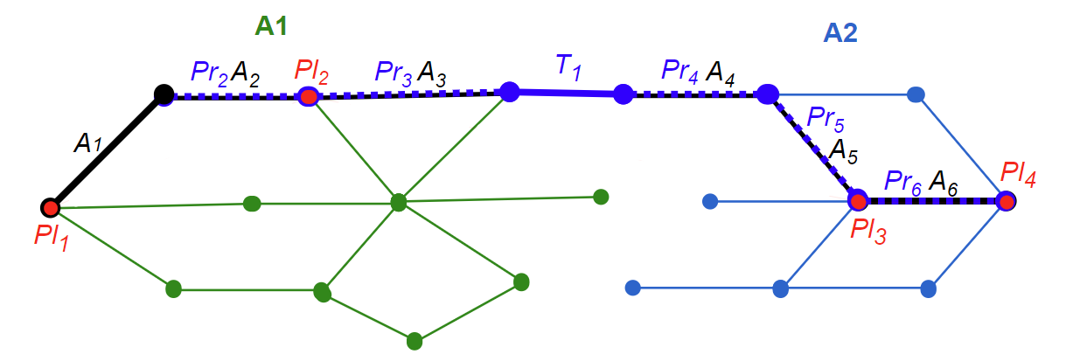
Data Processing
Actual Network Path
Predict Planned Path
Probabilistic Prediction Model
Modal next edge
Mean edge duration
A1 A2 Train Describer Networks
A_{n} Actual Network Path
Pl_{n} Timetabled locations
Pr_{n} Predicted Planned Path
T_{n} Transitions between Networks

Slide 13
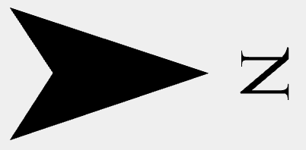
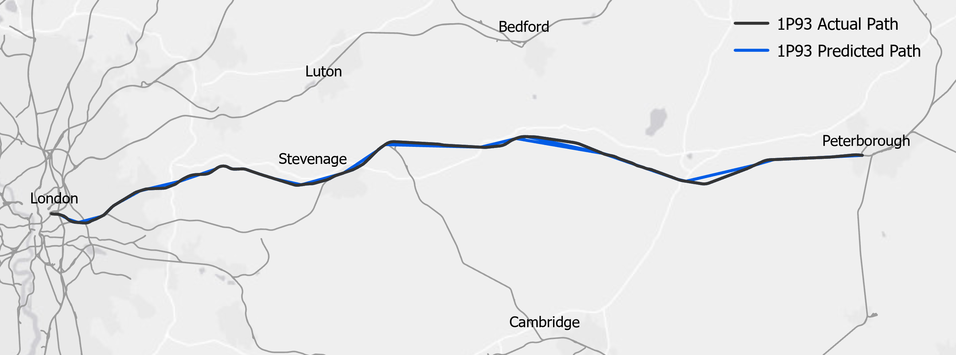
Calculation
Geospatial Route
Utilisation

Slide 14
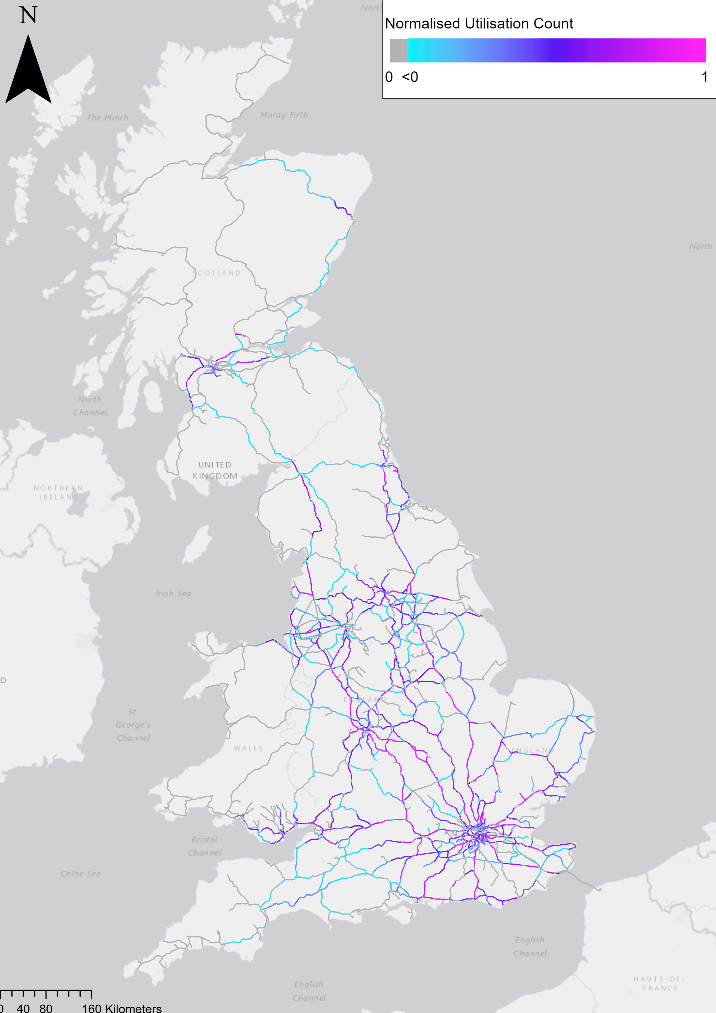
Calculation
Geospatial Route
Utilisation

Slide 15
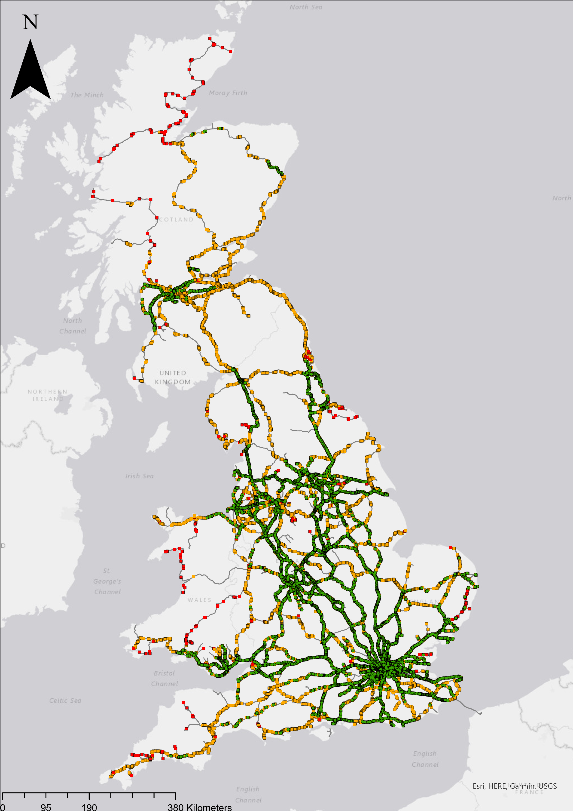
Challenges
Data quality
Data availability
Impact of Poor Data

Slide 16
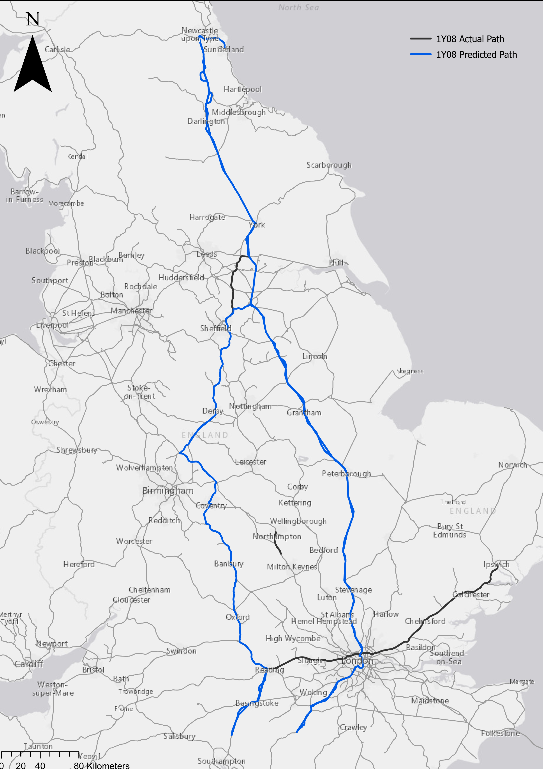
Challenges
Data quality
Data availability
Impact of Poor Data

Slide 17

Results
11th to 23rd July 2023
26.5 million train movements
7.8 million planned locations
149,473 out of 181,181 trains successfully calculated (82.50%)
Normalized Actual Utilisation
Normalized Planned Utilisation

Slide 18
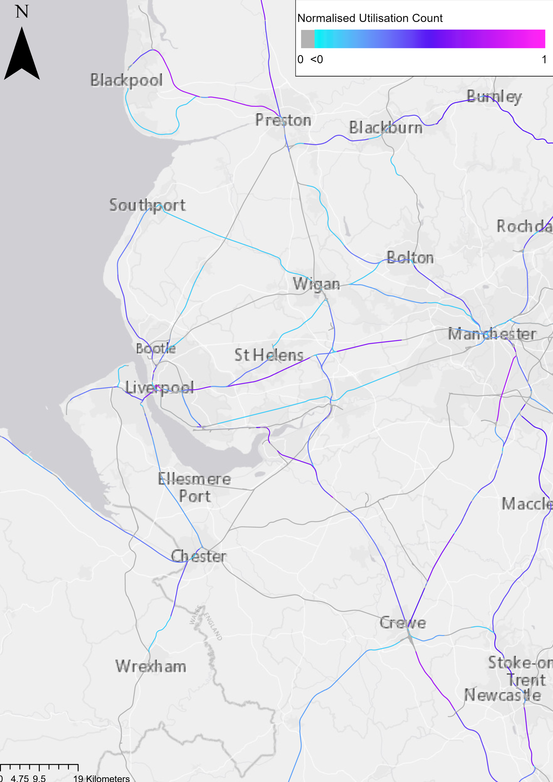

Results
Industrial Action 20th July
On Strike:
TransPennine Express
Northern
Avanti West Coast
Not On strike:
Merseyrail
Transport for Wales
19th July Normalized Actual Utilisation
20th July Normalized Actual Utilisation

Slide 19
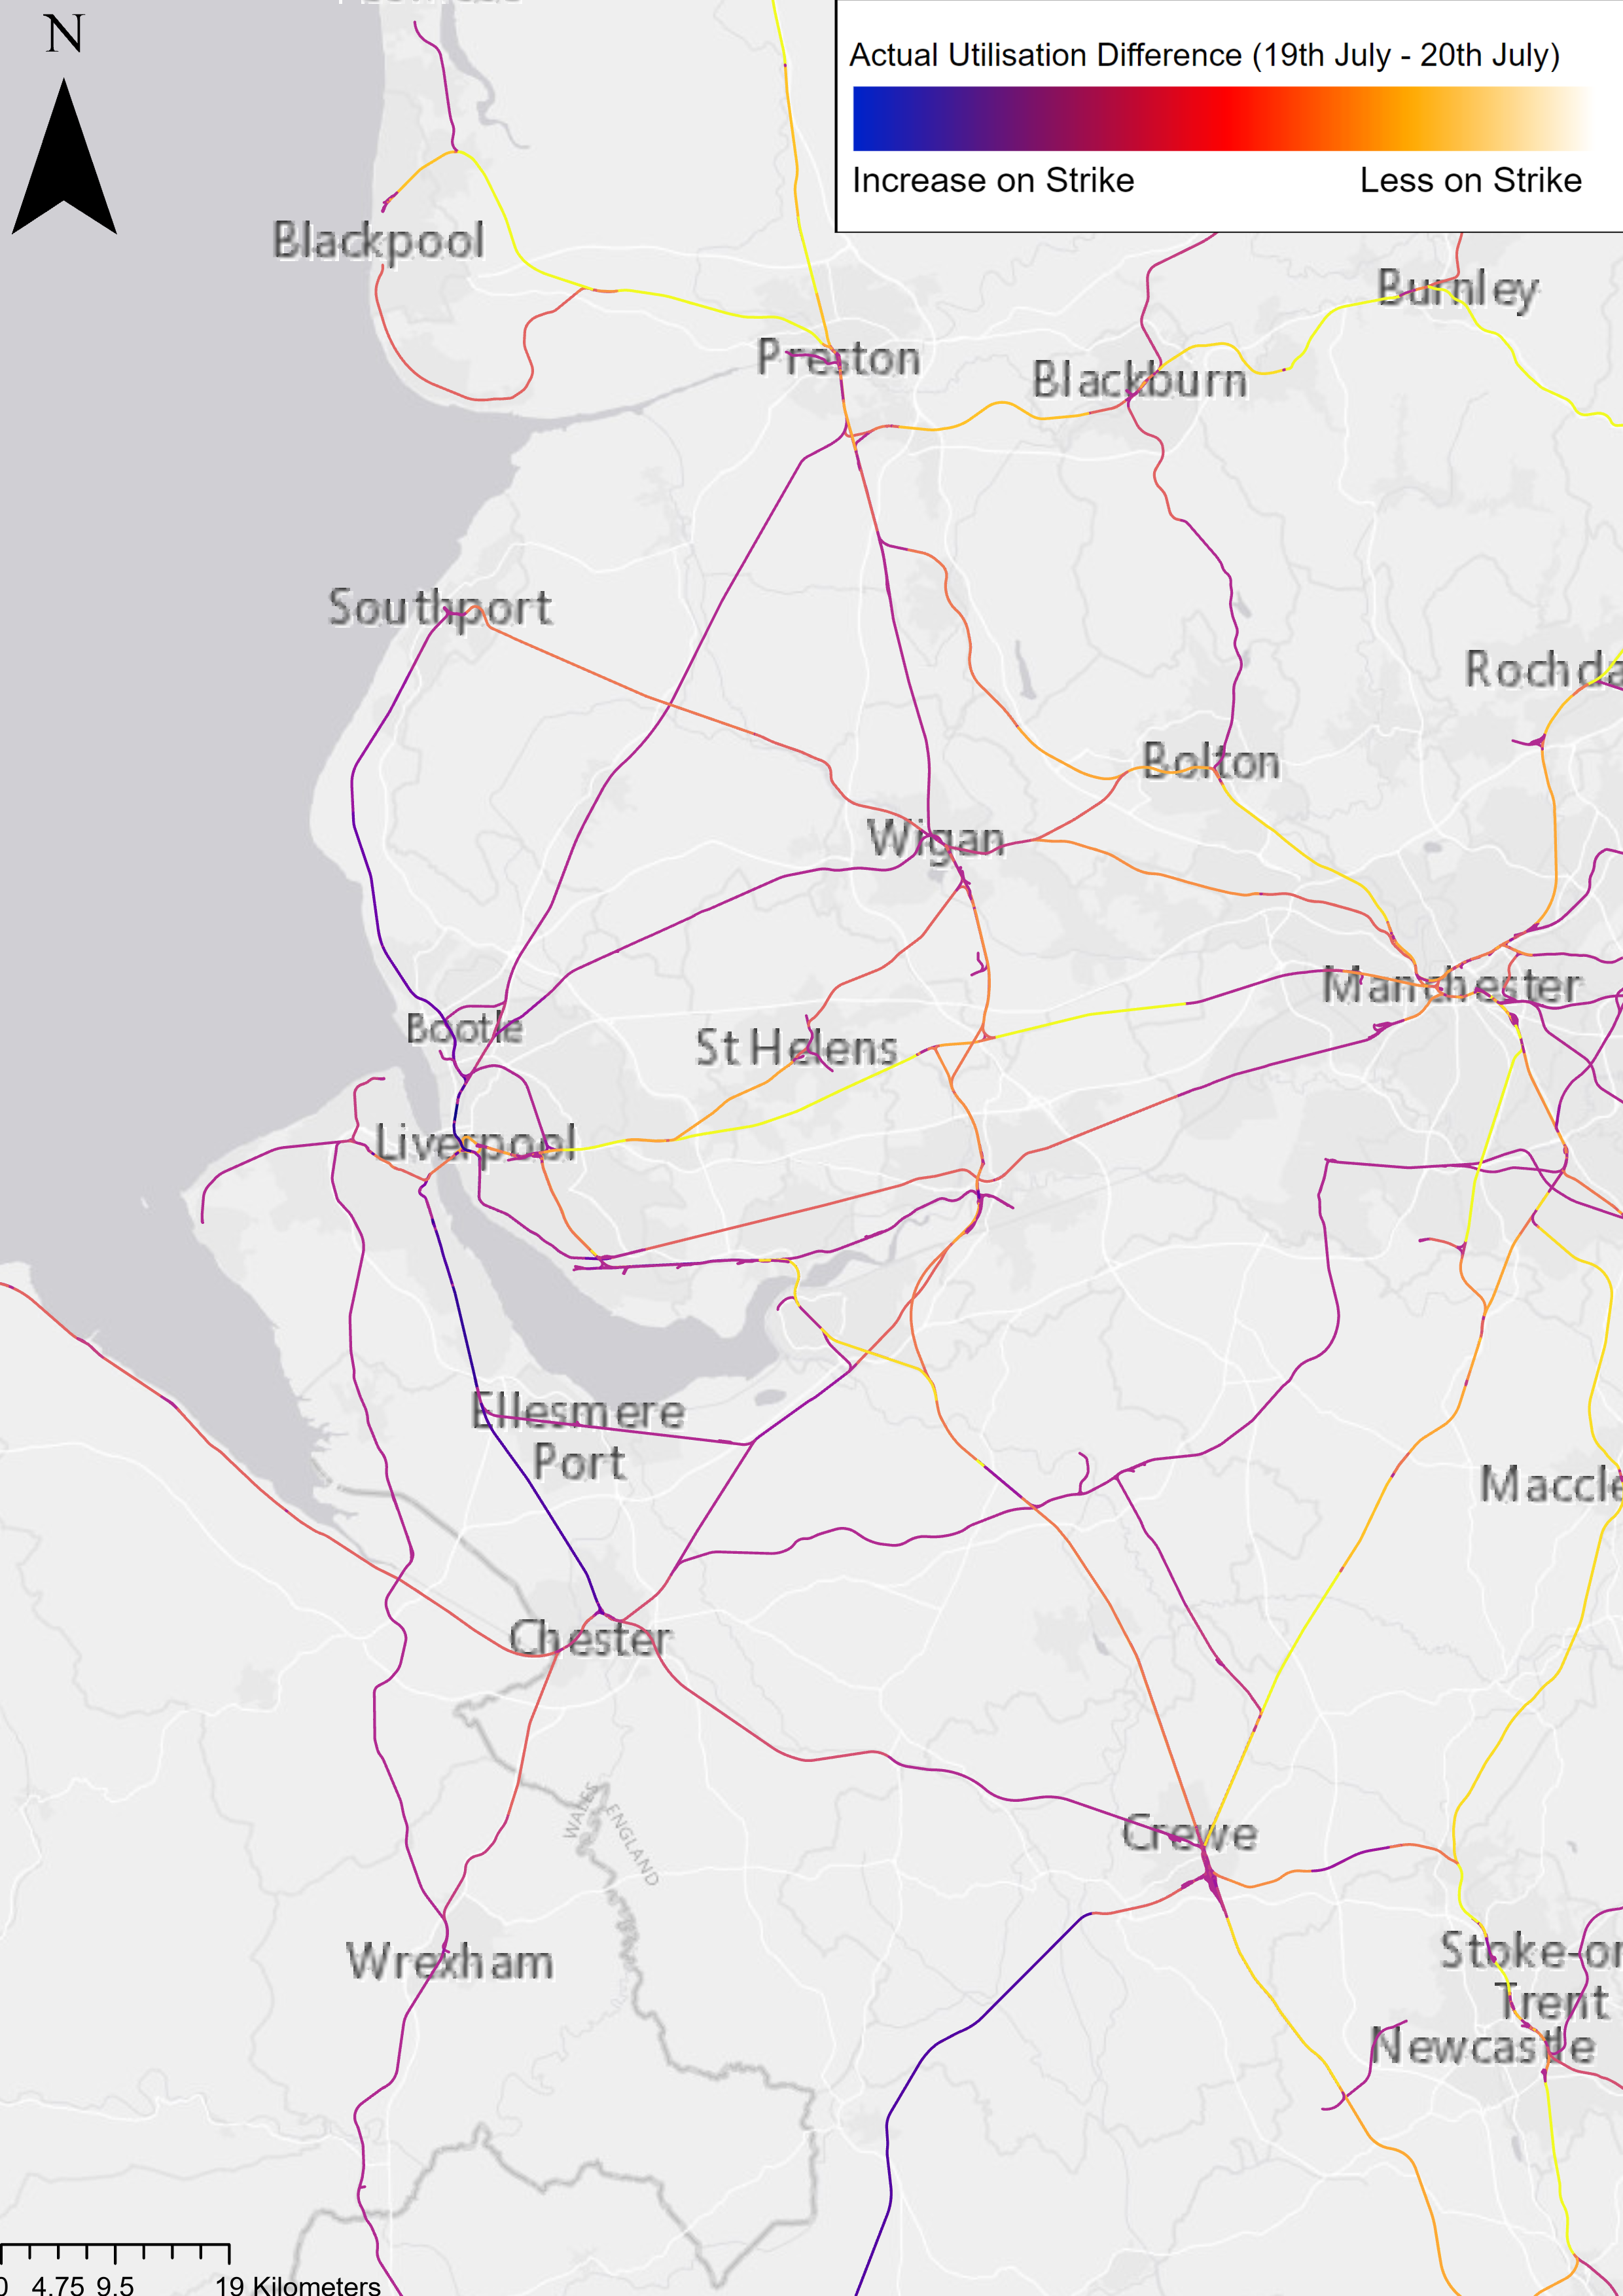
Results
Industrial Action 20th July
On Strike:
TransPennine Express
Northern
Avanti West Coast
Not On strike:
Merseyrail
Transport for Wales
Actual Difference between 19th & 20th July 2023

Slide 20
Conclusions
Method has potential, strike days indicate this
Currently limited by data quality and availability
Actual Difference between 19th & 20th July 2023

Slide 21
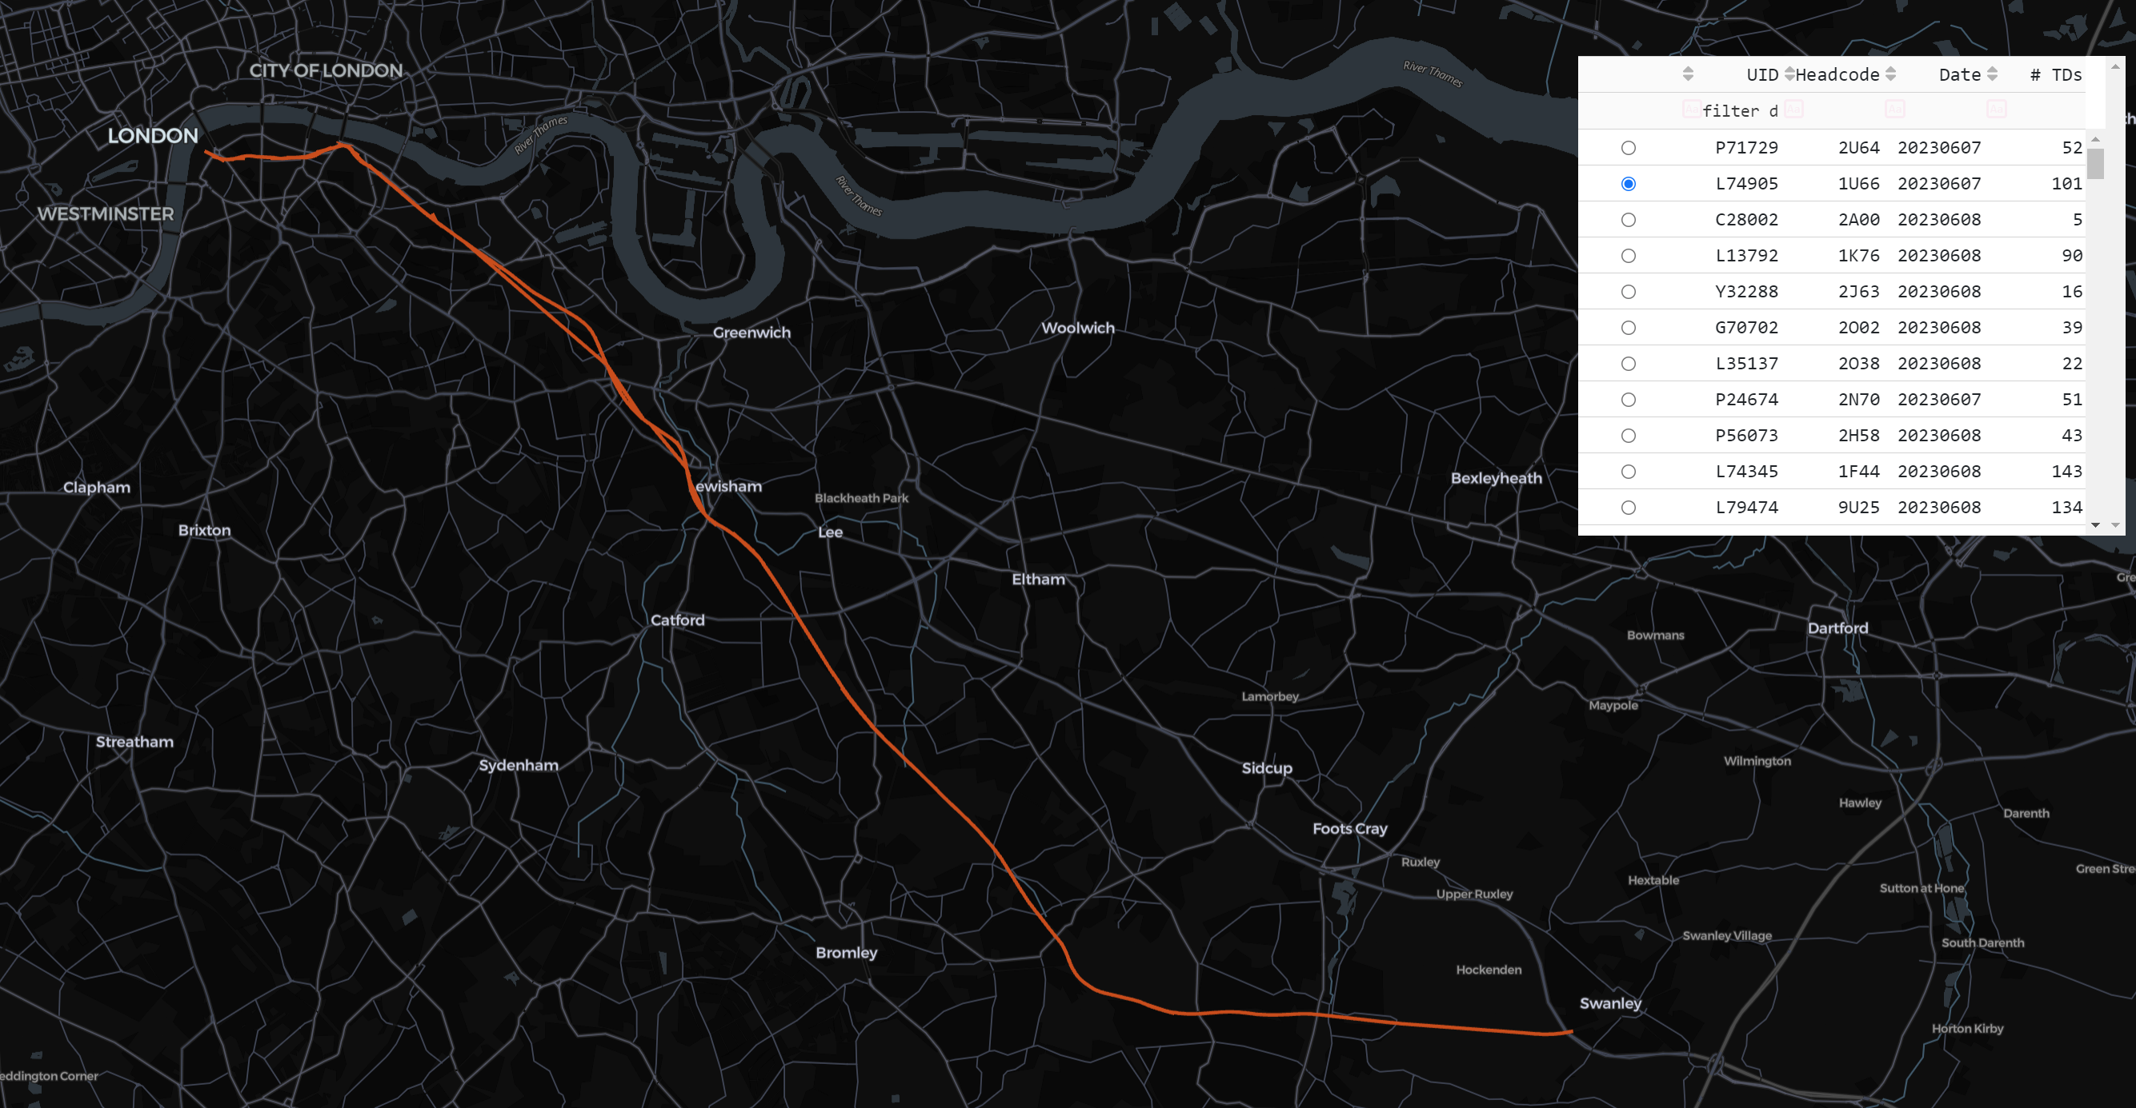
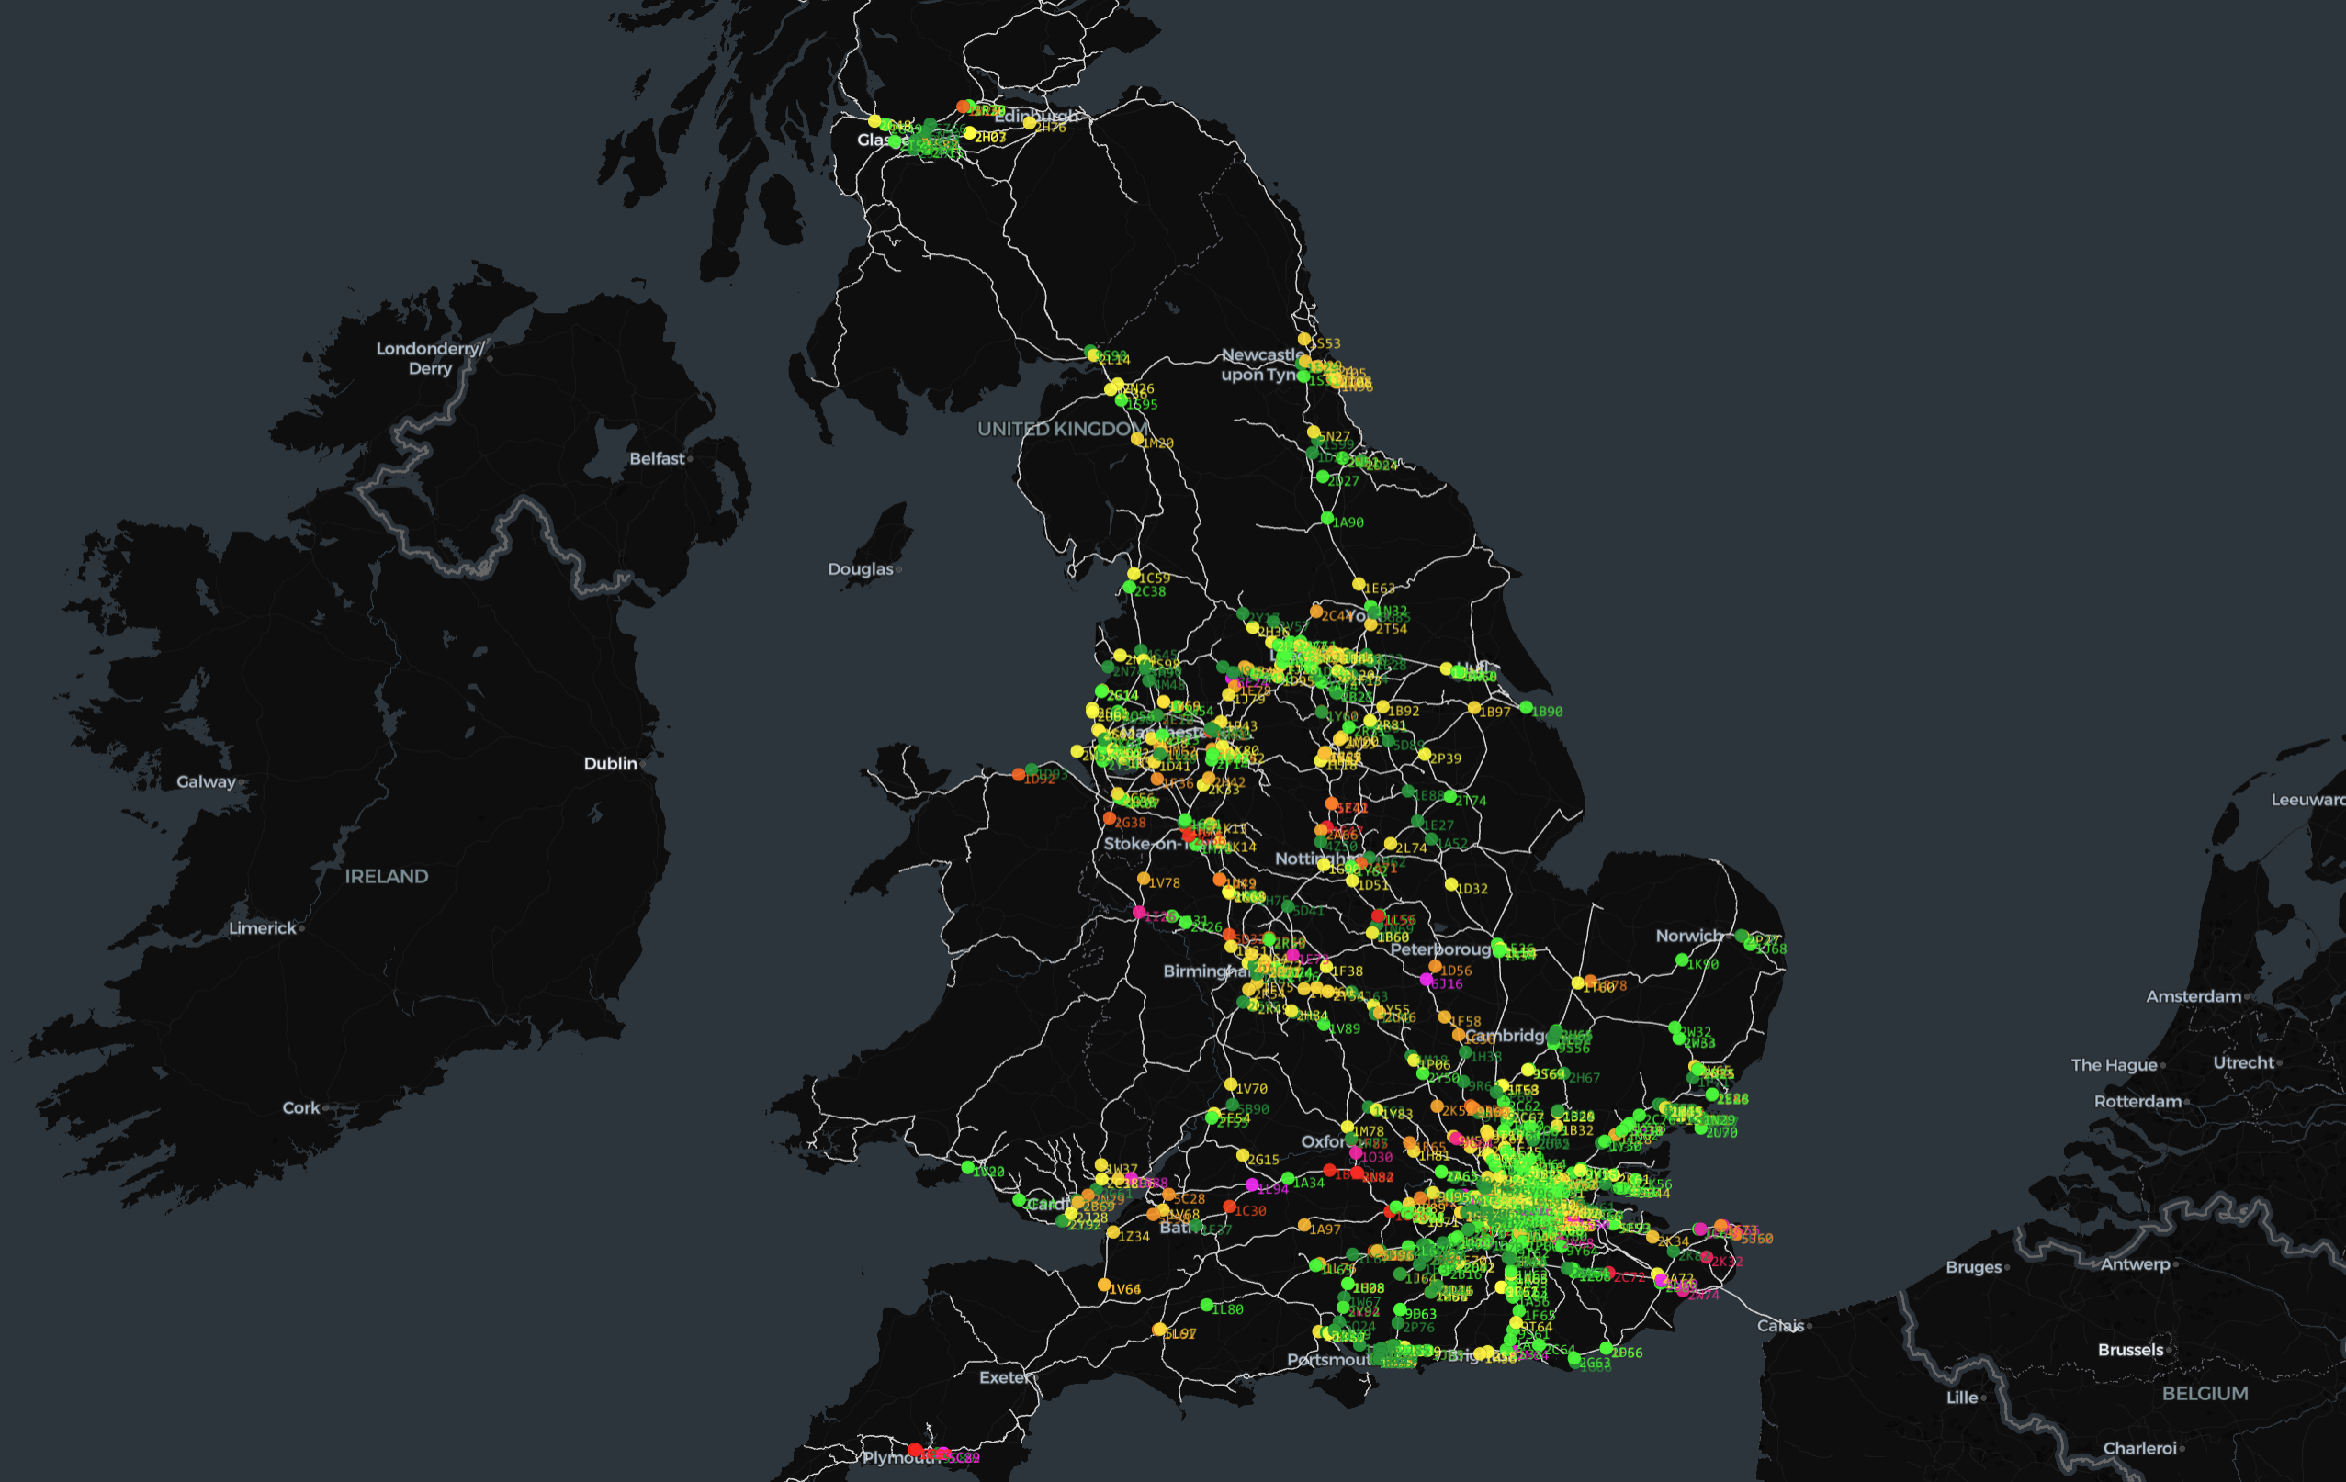
Further Work
Data Quality Improvements
Utilisation & Capacity Methods
Realtime
Incident Detection
Historical Analysis
Realtime Detection

Slide 22
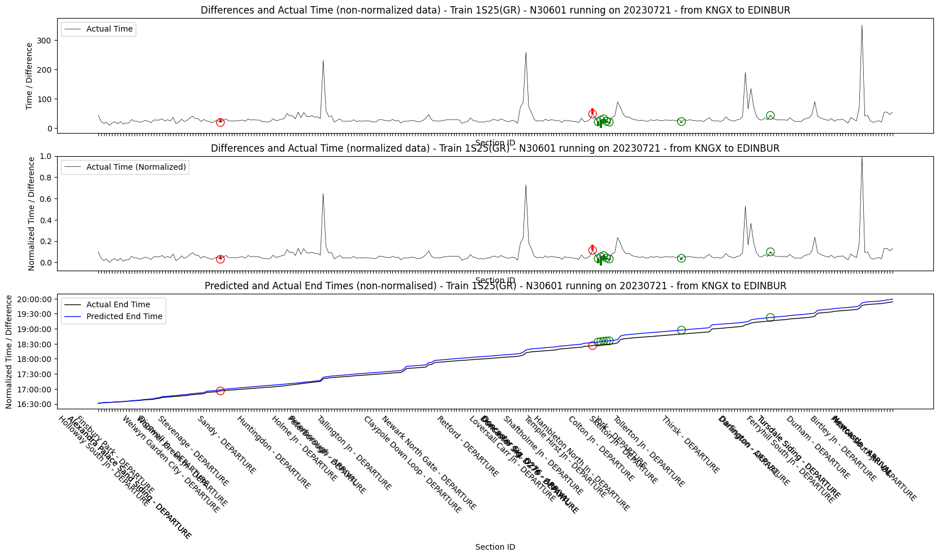
Further Work
Data Quality Improvements
Utilisation & Capacity Methods
Realtime
Incident Detection
Historical Analysis
Realtime Detection

Slide 23

Analysing Railway Infrastructure utilisation A Geospatial Approach
Any Questions?
Further details

